Slide 1

Celebrity Location Identification for Paparazzi
(C.L.I.P.)
W201 Group Project 1
2019 October 15th
Authors: John Lee // Alyssa Augsburger // Derek Topper
Audience: CEO/COO of Paparazzi Agencies
Notes:
John Slide:
Hi and thank you for attending this presentation on Celebrity Location Identification for Paparazzi. The authors of this presentation are John, Alyssa, and Derek and we are all Data Science graduate students at UC Berkeley. Today, we are speaking to C-Level employees of Paparazzi Agencies. We will introduce some problems faced in the paparazzi industry and explain how data science can be applied to resolve these issues.

Slide 2

Overview
Domain
Organization
Stakeholders
Entertainment Industry
Celebrity Photography
Paparazzi agencies: MB Pictures, Bauer-Griffin, X17, Splash News, TMZ
CEO/COO of company
Photographers - Freelance, Employees
News Agencies / Consumers
Notes:
John Slide:
Paparazzi (the plural form of paparazzo) are photographers who capture photos of celebrities for publications. They spend time, strategically, waiting for celebrities, lining up the perfect shot, and fending off hordes of other paparazzi get the best picture. Then they can sell the pictures to magazines.
Paparazzi operate in the domain of the entertainment industry. Their photos are helpful when used to illustrate current pop culture events such as who won a grammy award or what drugs did a washed-up celebrity get caught with (this time)?
Some paparazzi organizations who will benefit from this information include the infamous TMZ. These organizations employ paparazzi to gather images of celebrities and sell them to news agencies. Some organizations also have their own news media outlet and distribute these photographs themselves to everyday consumers of gossip magazines, for example.
The stakeholders involved include:
1) Those high-level decision makers of paparazzi agencies who will decide whether or not to employ these strategies
2) The paparazzi themselves who will be impacted by the business decisions. They are also apart of the qualitative research to help improve the data science strategies.
3) News agencies or consumers who will benefit from more valuable content and a lower cost

Slide 3
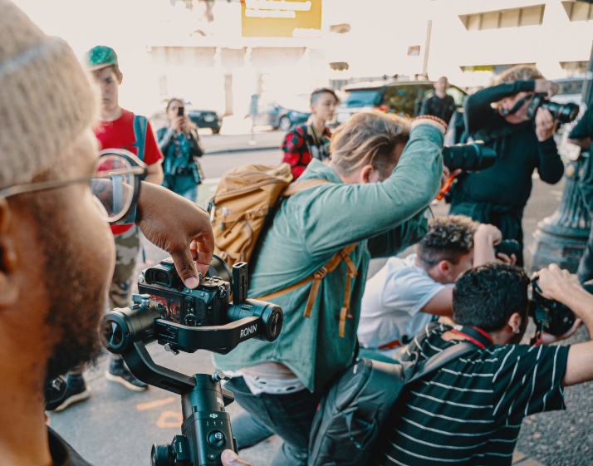
Brief History
“Gold Rush” Era vs. Great Recession and Rise of Online Media
Freelance to Multinational Agencies
Citizen Photography
Notes:
John Slide:
After the Great Recession and rise of Online Media, there was a decrease in value and an increase in demand for celebrity photographs. The decrease in value comes from improvements in technology allowing everyday citizens to capture their own photos to sell. Also, the rise of social media such as instagram flooded the society with free photos. The increase in demand is also a side effect of social media where websites try to lure consumers to their page with more and more photographs.
While freelance photographers dominated once before, there has been a shift to multi-national agencies who have own team of paparazzi and own brand of entertainment news and online blogs.
With increased competition, lower returns of photographs, and centralization of photographers, data science can help give an edge to paparazzi organizations.

Slide 4
Business Problem and Research Question
Core Problem: To Most Efficiently Utilize Paparazzi’s Time to Capture Valuable Celebrity Photos
Time
Idling time - waiting and traveling
Number of other paparazzi or citizen photographers in same area
Where should the paparazzi be and at what time?
Valuable Content
High value photos depend on speed at which they can be distributed
Celebrity popularity
How to include photo value into celebrity location models?
Notes:
John Slide:
The core business problem the paparazzi face is to most efficiently utilize their time to capture valuable photos.
This problem is separated into the time and content value aspects:
A paparazzi’s time is important. Each idling minute waiting at or traveling to a wrong location delays an entertainment company from publishing another “hot” article. Additionally, the paparazzi are competing with each other and everyday citizens to deliver celebrity photos. If someone else captures these photos before your paparazzi does, the value of your photos drop. If your blog does not post an article with these images first, your blog may not trend on the next google search. All of which leads to less dollars going to your pockets. Therefore, we must consider “Where should the paparazzi be and at what time?”
The content value is important as well. One must also determine what consumers are most interested in. Is it worth it to follow a boring celebrity drinking coffee so your content is unique from less competition? Or is it better to follow an “A-List” celebrity for the chance that they might do something crazy? We need to determine all relevant variables that can help prioritize which celebrity the paparazzi should follow to answer the question “How to include photo values into celebrity location models?”

Slide 5
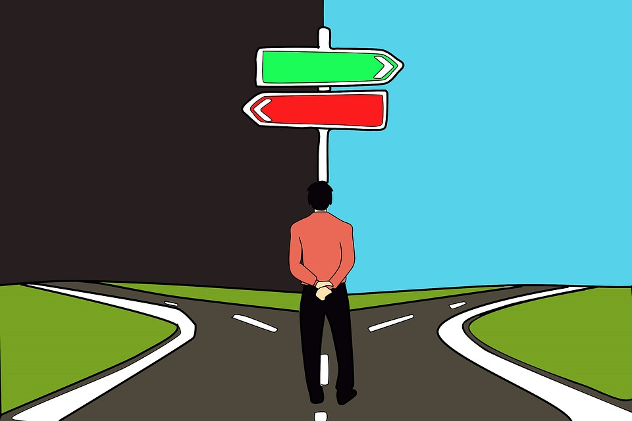
Decision and Decision Maker
Decision: Should a paparazzi agency employ data science technology/methods in order to utilize paparazzi most efficiently?
Potential benefits of increased efficiency:
Reduced costs (fewer paparazzi, less idling time)
Increased revenue (producing more quality photos)
Decision Maker: CEO/COO of paparazzi agency
Notes:
John Slide:
To help solve the business problem, we believe that data science technology can help. The benefits include reduced costs and increased revenue. However, the C-level decision makers must also agree.
The following slides outline several data collection and data analysis methods so that the decision to employ data science strategies for paparazzi deployment will become more clear.

Slide 6
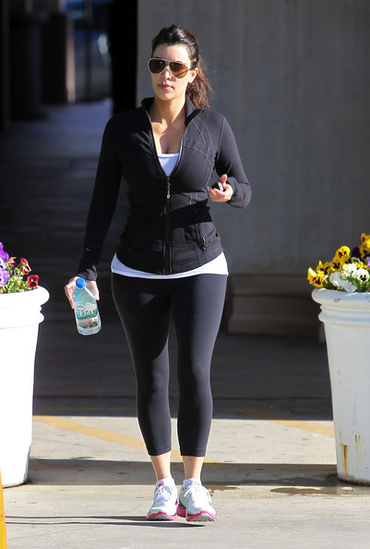
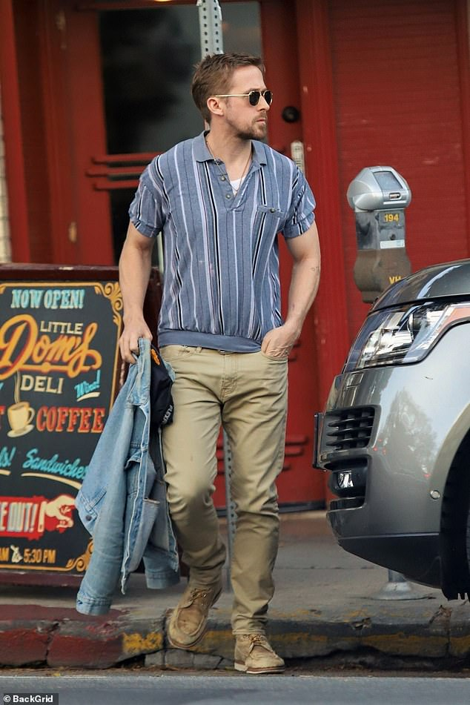
Quantitative Data Collection
Past photo data
Existing first-party database
Web-scrape to find photos from other companies
Large volume of location data
Instagram photos
Natural language processing of tweets and articles
Filming locations
Celebrity websites
Notes:
Alyssa Slide:
We will collect a variety of quantitative data in order to determine how to more efficiently utilize and deploy paparazzi.
We will look at paparazzi photo history from the individual first-party database of the company we are working with and also web scrape to find past photos from other companies.
We will also collect a variety of location data from various sources:
Instagram, in order to see at what locations celebrities have posted photos in the past
We will also collect data from twitter and use natural language processing to look at tweets to understand locations that celebrities frequent.
Websites to see where celebrities are filming or where they have shows and concerts
The past photo data and location data will allow us to:
Look for trends in locations, time of day, day of the week
Understand the popularity and unpopularity of each celebrity by looking at the value of each photo.
We will be careful to avoid selection bias in our data collection - so we will not only look at past popular photos that have earned a lot of money, but also unpopular photos, that did not earn a lot of money.
As well as consider the more popular celebrities, but also the less popular celebrities.

Slide 7
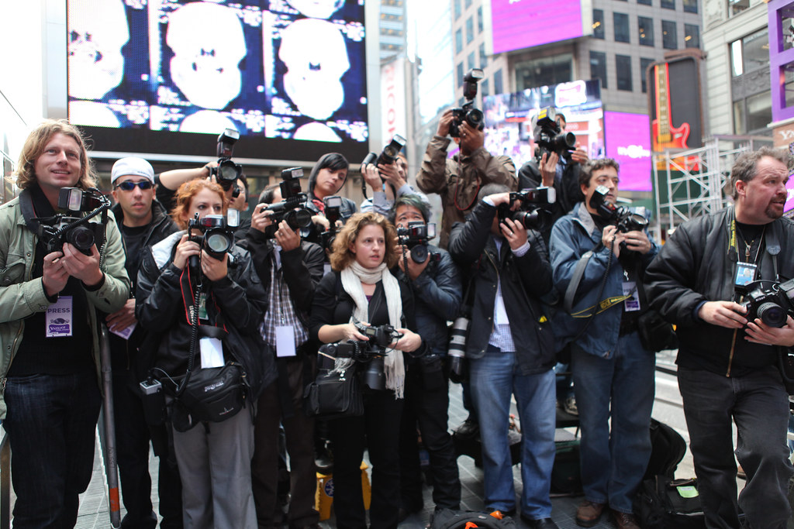
Qualitative Data Collection
Interview paparazzi
What makes a profitable photo?
How to determine popular and unpopular locations?
How to determine popularity of celebrities?
What has enabled them to be successful in the past?
What has hindered their success in the past?
Notes:
Alyssa Slide:
In addition to collecting quantitative data, we will collect qualitative data by interviewing paparazzi
We will interview paparazzi to understand how they currently operate and ask about their past experiences.
We will interview a sufficient number of paparazzi at the company to ensure we have a sufficient sample size and number of data points
Additionally, in the interviews with the paparazzi we will avoid any bias by considering how we frame our questions in order to ensure we do not lead the paparazzi to answer in a certain way.
When the paparazzi share their experiences in the interviews, we will be conscious of fallacies, specifically the Misleading Vividness Fallacy. Their stories about their experiences could really resonate with us, but we will ensure that we use the data and information from the interviews to make a decision about the best way to implement a solution to efficiently manage paparazzi.
Interviewing the paparazzi will help us consider things that we didn’t know and couldn’t have gathered from other quantitative data.
The data we gain from these interviews will drive how we build and assign the variables in our models.
Collecting both quantitative and qualitative data, as well as data about successful and unsuccessful things, will allow us to incorporate a wide VARIETY of both structured and unstructured data into our solution.

Slide 8
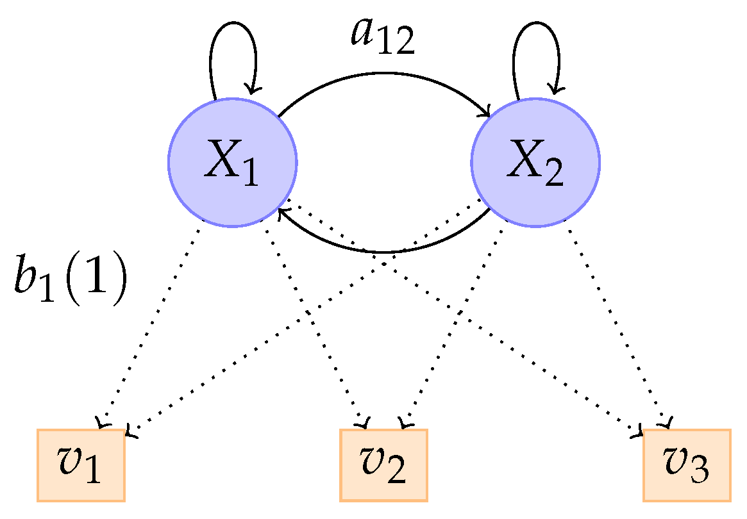
Modeling Locations
Our plan is to use a multi-pronged approach to generating our models.
Considering our data collection processes and past research, we plan on employing the following techniques:
K-means clustering algorithm
Group different types of locations based on their innate characteristics such as type of establishment, neighborhood, number of previous visits, etc.
Hidden Markov Model
Model of where celebrity is at a given time, as it allows us to project the spatio-temporal positions of celebrities.
Sub-Trajectory Synthesis
Converts historical location trends into “synthesized location trajectories” and will allow us to consider various patterns of movement as well as maintain the privacy of our data, in case of a company data leak, as it uses fewer location points than a traditional data model.
Notes:
Derek Slide:
Our plan is to use a multi-pronged approach to generating our models.
Previous research into the identification of someone’s location has been conducted using a two pronged approach using a technique known as a Hidden Markov Model and a form of K-mean clustering.
K-means clustering algorithm
Group different types of locations based on their innate characteristics such as type of establishment, neighborhood, number of previous visits, etc.
Hidden Markov Model
Model of where celebrity is at a given time, as it allows us to project the spatio-temporal positions of celebrities.This is a statistical technique that allows us examine observable events (where a celeb is), as well as unobserved events (different times and other variables).
We will also implement a method known as named Sub-Trajectory Synthesis, which was developed by researchers at Microsoft Asia. This is a location prediction method that
Converts historical location trends into “synthesized location trajectories” and will allow us to consider various patterns of movement as well as maintain the privacy of our data, in case of a company data leak, as it uses fewer location points than a traditional data model and is operationally better
This allows an algorithm to identify many more location trajectory options, which allows to examine many more potential location probabilities.

Slide 9
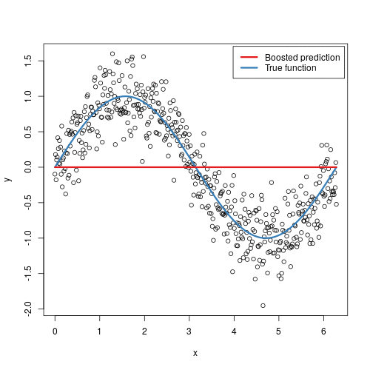
Modeling Where To Go Based On Celebrity Value
We also plan to model the value of seeing a particular celebrity.
To better place our photographers, we need to understand which celebrities should be targeted by our paparazzi.
To tackle this, we’ll combine the following methods:
K-means clustering of different types of celebrities.
Formalize celebrity groupings and develop clusters of celebrity quality for each celebrity, based on their popularity and fame.
Gradient Boosting Machine Learning Models
A statistical method that uses decision trees to provide a regression based approach to predicting a value, in our case, how much a photo of a celebrity is worth.
Using the aforementioned clusters, and historical data on company photo sales, we can predict exactly how much a potential future photo will sell for and thus, let us know where to send photographers to maximize profits.
Notes:
Derek Slide:
We’d plan to build a model to predict the locations that celebrities are more likely to be located at as well as where we should go to best maximize our celebrity value.
Our model will include two methods.
K-means clustering of different types of celebrities.
Formalize celebrity groupings and develop clusters of celebrity quality for each celebrity, based on their popularity and fame.
Gradient Boosting Machine Learning Models
A statistical method that uses decision trees to provide a regression based approach to predicting a value, in our case, how much a photo of a celebrity is worth.
It would take in various info like Alyssa outlined earlier.
Using the aforementioned clusters, and historical data on company photo sales, we can predict exactly how much a potential future photo will sell for and thus, let us know where to send photographers to maximize profits.

Slide 10
Decision
Perform a 3 month trial
Deploy half of the paparazzi to locations based on what the model recommends
Deploy half of the paparazzi using the existing strategies
Compare the number of photos taken and revenue generated per day between the 2 groups
If the paparazzi are able to obtain more photos when deployed using the model’s recommendations, then we would suggest continuing to use the model
Using a trial and comparing results in order to make the decision, will help to avoid any bias in the decision making process
Notes:
DEREK Slide:
We propose running a 3 month trial with the model to assess the benefits of it.
A/B Testing by deploying half the paparazzi to the locations the model recommends, while the other half of the paparazzi continuing using the existing strategies to determine where to go.
Compare the number of photos and revenue obtained per day between the 2 groups
this could be our standard of proof that the model works and we would recommend want to see the model on a daily basis to deploy paparazzi.
Being able to compare the results with and without the model will help to avoid any bias in the decision making process
It would be easy to want to stay with the status quo and not implement anything new, but if the model enables paparazzi to obtain more photos, this would result in increased profits for the company.
It could be easy to think that in hindsight it is easy to know where and when celebrities will be in certain locations, but we do know that it is difficult to predict what humans will do and when. We believe that using a wide variety and a significant volume of data to predict celebrities’ whereabouts will be much more accurate.

Slide 11
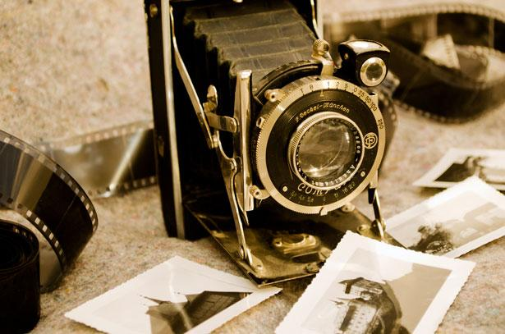
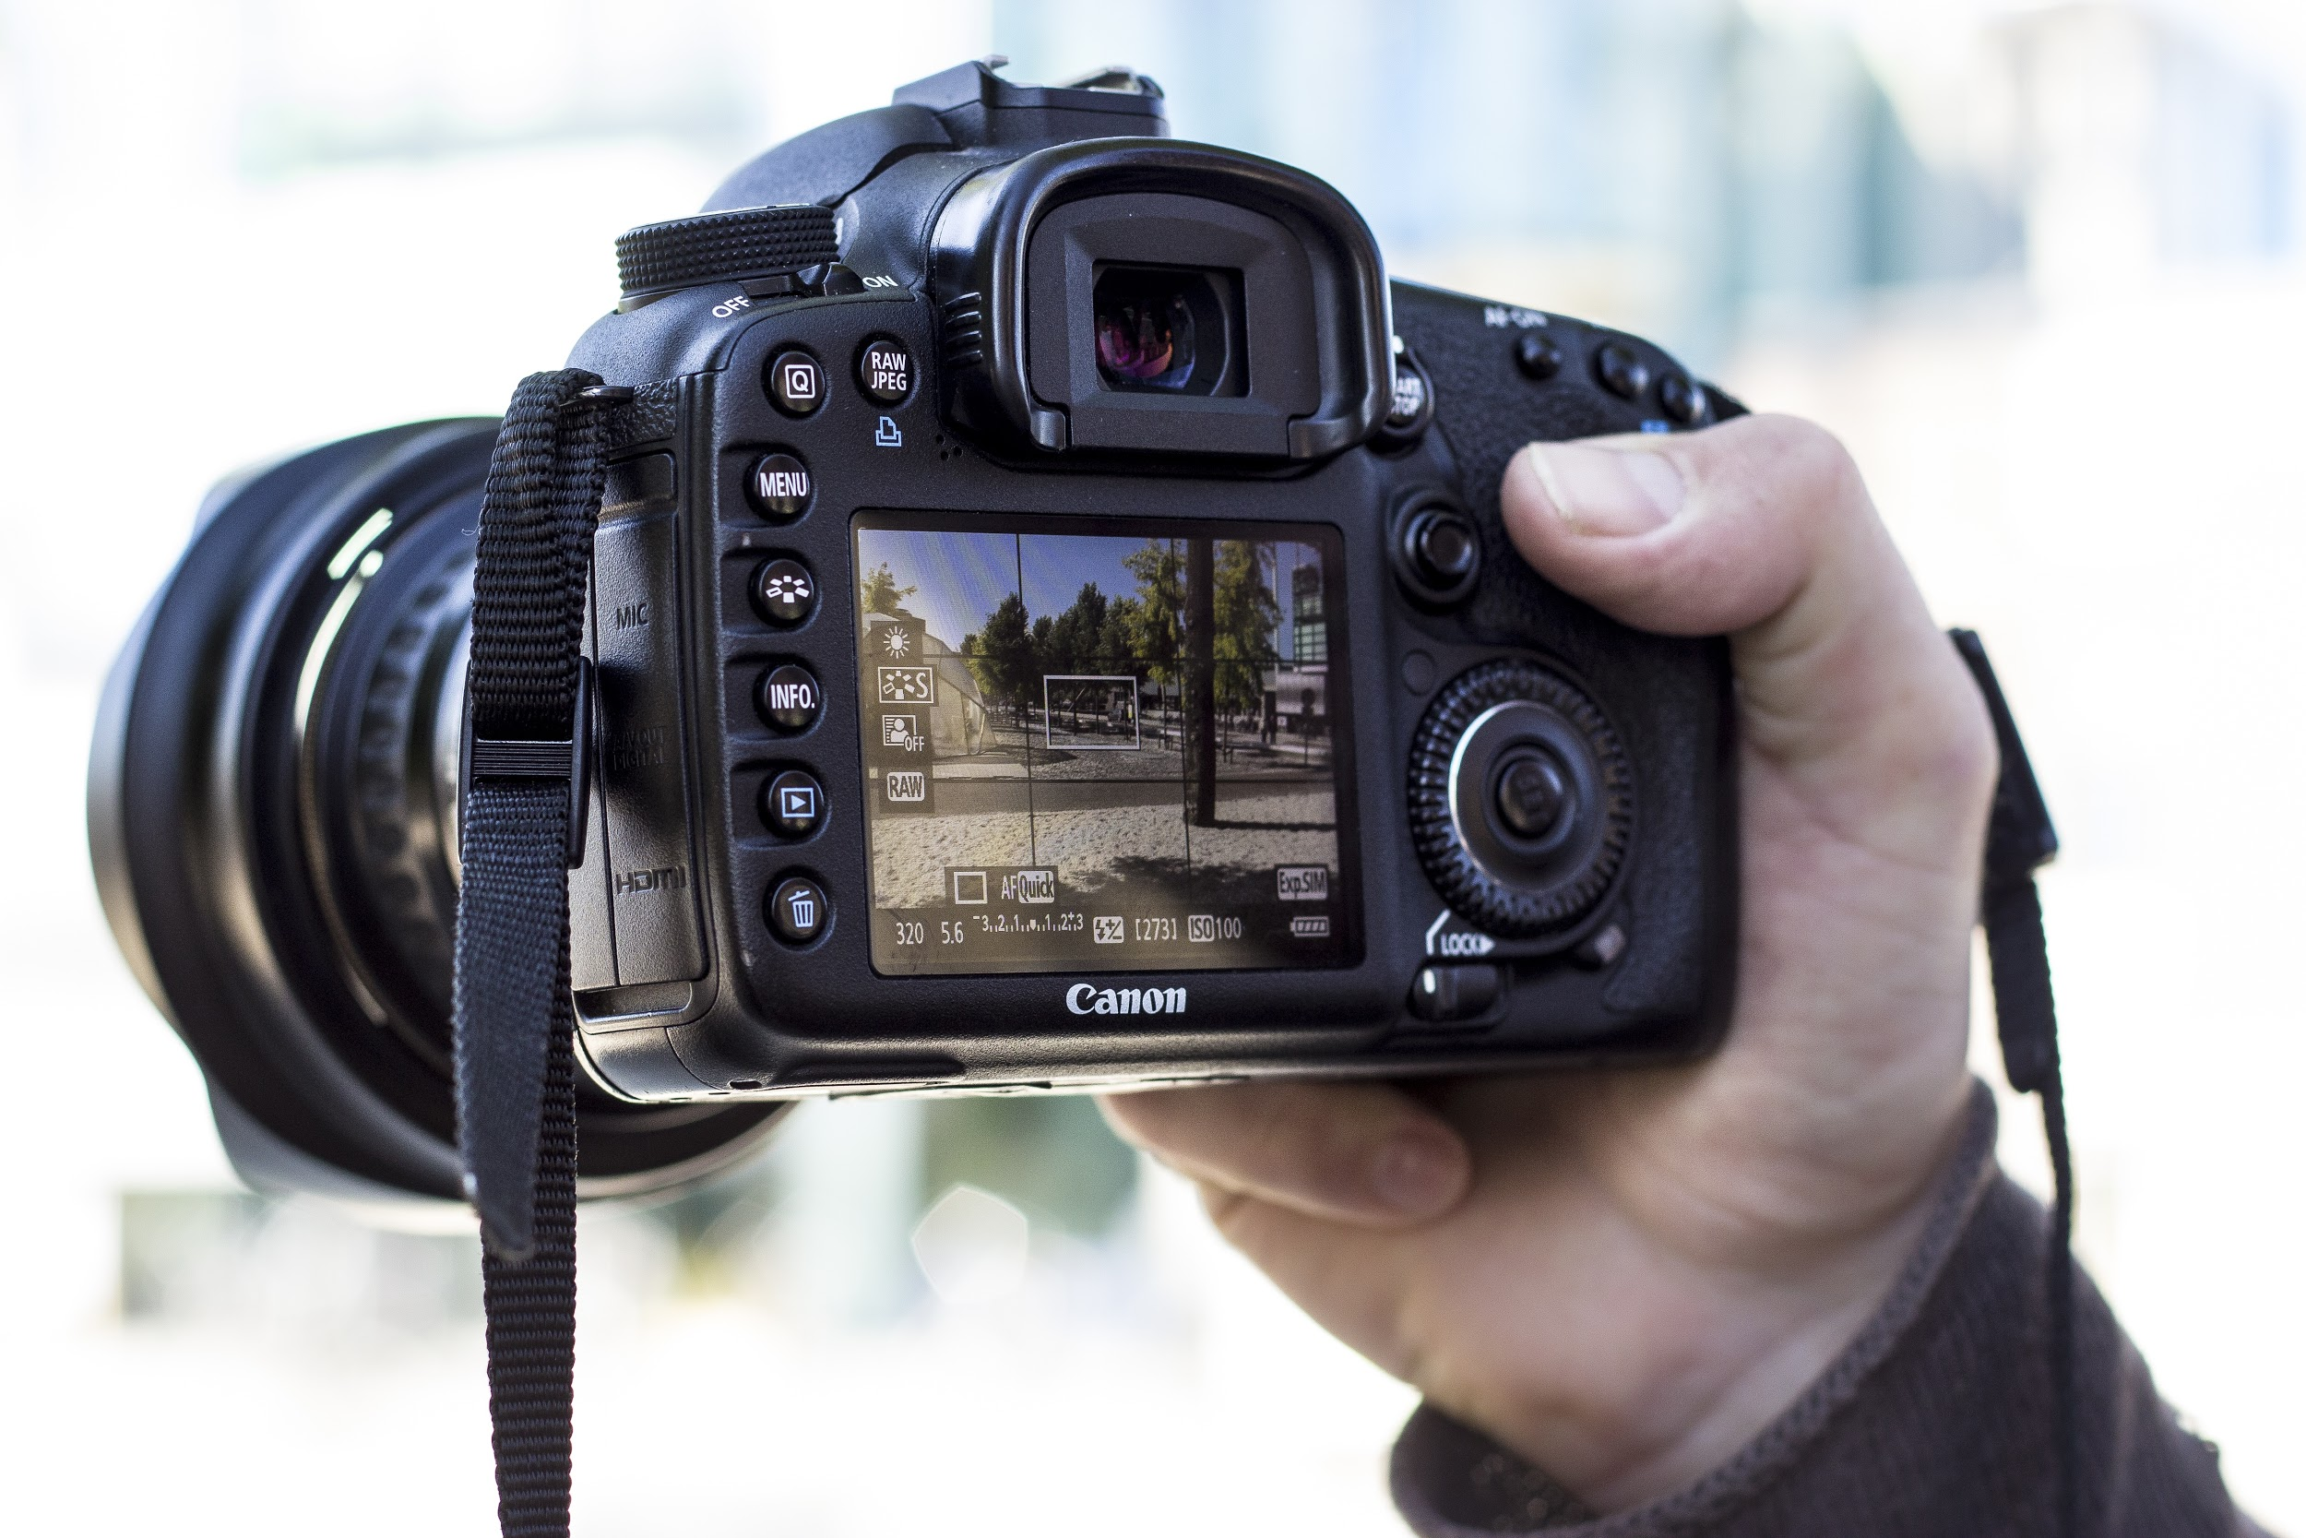
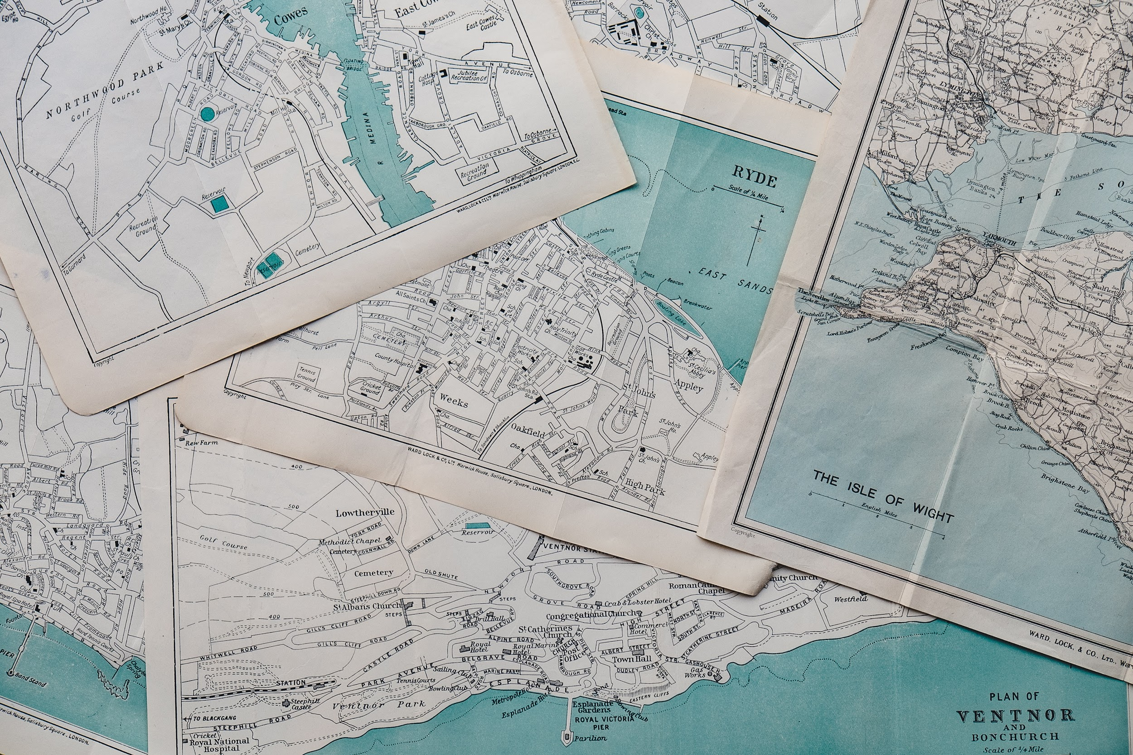
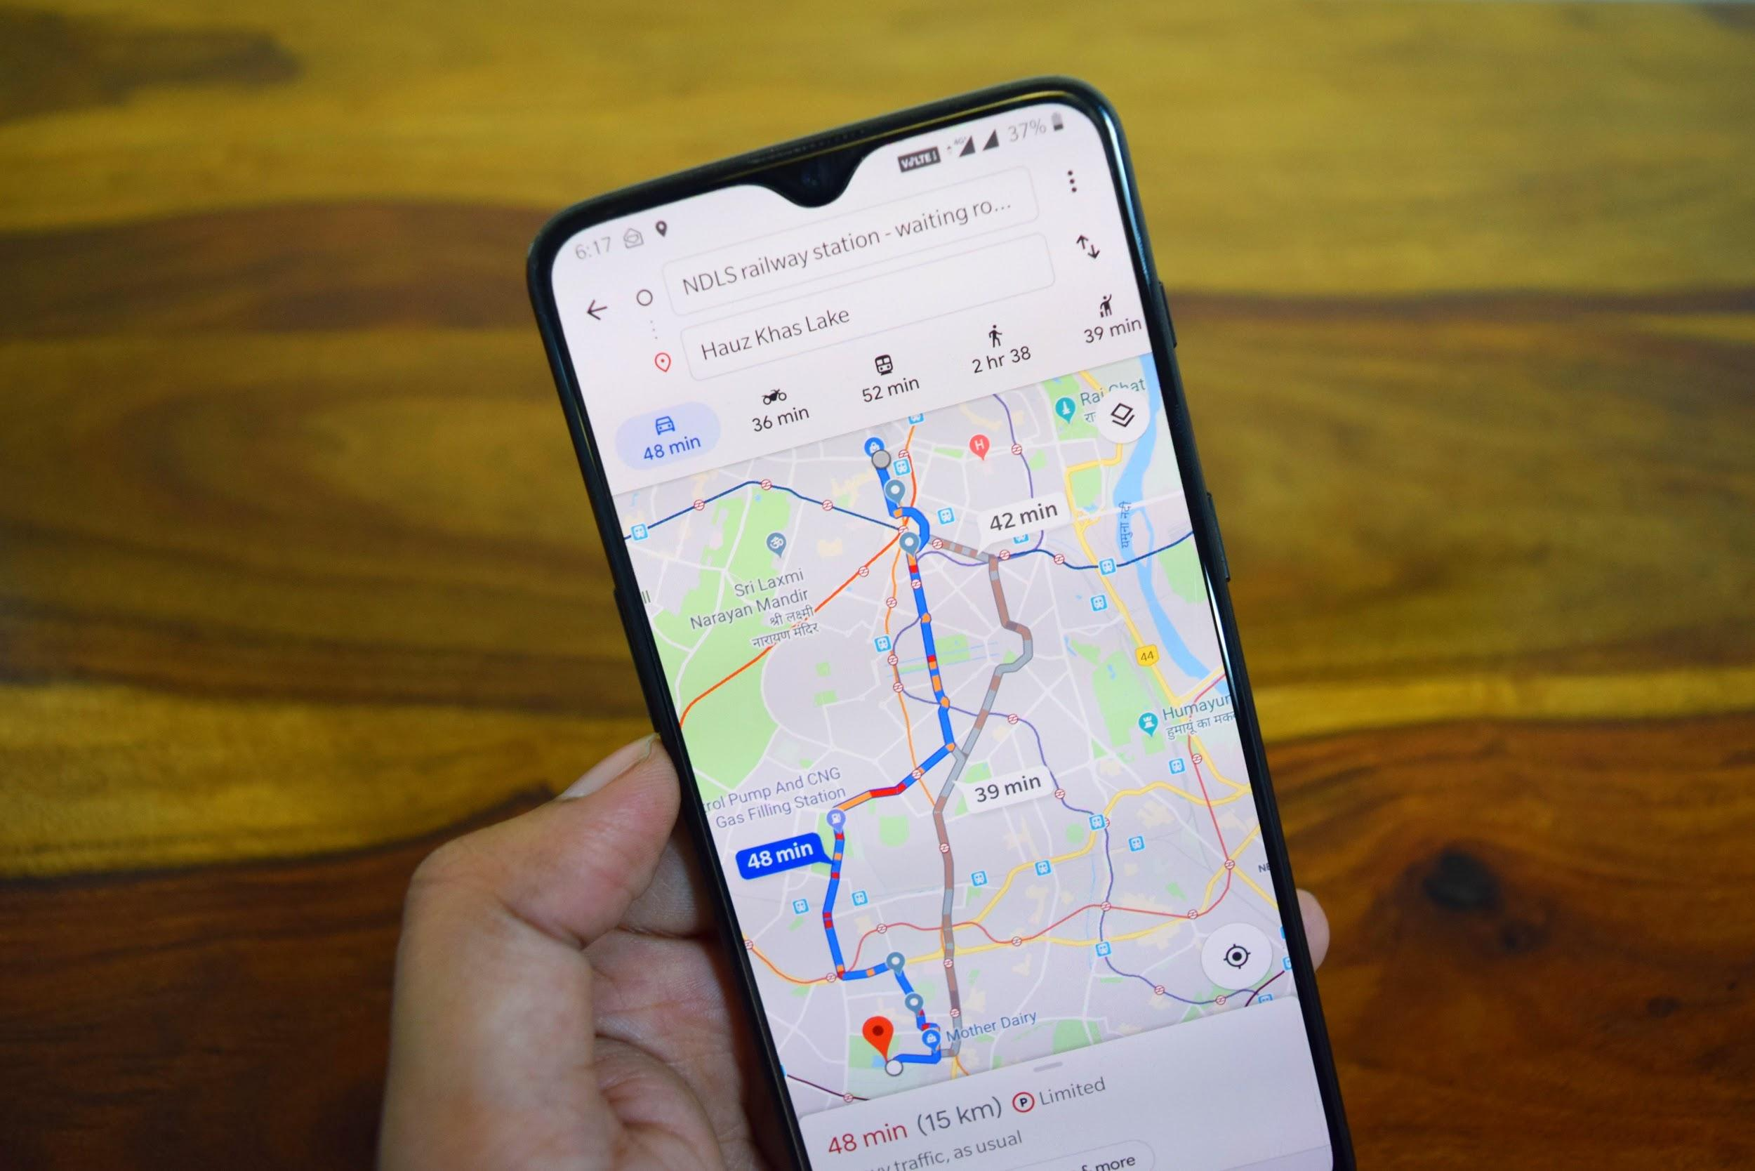
The Impact and Response of Data Science for Paparazzi
Organizational Impact:
More accurately deploy paparazzi for higher probability of celebrity sighting
Increase paparazzo efficiency - better utilize their time
Better content
Increase potential for more high quality photos - diversification
Organizational Response:
Increase job satisfaction & job performance
More customers & larger pool of consumers
Mitigating risks
Increase revenue and profits
Notes:
ALYSSA Slide:
The strategies and model we have proposed will help paparazzi organizations operate more effectively and efficiently.
By more accurately deploying paparazzi, they will spend less time driving and waiting around in search of celebrities.
This can lead to reduced costs as well as an increase in job satisfaction and performance which leads to job retention.
Additionally by delivering better content, there will be more customers choosing your agency compared to others.
Increasing efficiency will allow paparazzi to capture more photos allowing agencies to diversify their photos. This in turn, increases the pool of consumers. Diversification also mitigates risks from certain celebrities or sectors becoming less popular such as when presidential elections are over and candidates are not as interesting or relevant.
In the end, data science methods can increase paparazzi effectiveness and efficiency ultimately leading to increased revenue and profits.

Slide 12
Challenges to Overcome
Celebrity Behavior Correlated to Avoid Paparazzi
Dynamic modeling
Limit method publicity
Ecological Fallacy
Avoid by using variety of data
Ethics
Establish boundaries
Study past failures (i.e. Gawker Map)
Ensure privacy of celebrity location history through aforementioned Sub-Trajectory Synthesis modeling
Notes:
ALYSSA Slide:
While data science methods can help paparazzi locate celebrities, there are also some challenges with this as celebrities can change their behavior to avoid paparazzi.
This challenge creates difficulty for static models that do not change. However, by using dynamic modeling that reacts to changing data, the model can be re-calibrated and paparazzi should be able to utilize these data science methods again.
Additionally, by keeping these models and methods private, and only used within the agency, it would be hard for celebrities to know which locations to avoid.
Additionally, keeping these models private prevents the public from gaining access to figure out how to stalk celebrities, which could lead to ethical issues.
With the proposed model, there is the potential for an Ecological Fallacy where one celebrity can appear more valuable than they truly are because one celebrity in the same group is very valuable. By using a variety of data in our model, this issue can be avoided.
There is also the challenge of ethics. Unethical behavior can be avoided by establishing boundaries within the agency. These boundaries can be developed by studying past failures such as the Gawker Map which was a public website where people shared sensitive celebrity information leading to legal actions against the company.
Additionally, as previously mentioned our model can be more accurate with less data, leading to the protection of celebrity location data.
Even though there are some challenges, we believe that the model will be very effective and useful for your company.

Slide 13
What’s Next?
Data science to help paparazzi agencies
Benefits to agencies, paparazzi, and consumers
Data collection methods take advantage of available free data
Data analysis methods are proven based on other applications
Decisions and impact are outlined
Challenges can be overcome
Will you help disrupt the entertainment industry?
Notes:
DEREK SLIDE:
We believe that data science can help paparazzi solve the core business problem of where paparazzi should be to most efficiently capture celebrity photos. The benefits will apply to paparazzi agencies, paparazzi, and consumers.
Collecting a wide variety and volume of both quantitative and qualitative data that is readily available, enables us to have great inputs into the model.
Based on previous research, we plan on continuing on branching out from this analysis. We can expand on previous research in building our model, which can increase paparazzi effectiveness and efficiency leading to increased revenue and profits for the company.
There are many technical challenges to overcome but we have developed a strong strategy of how to approach the problem and are confident that our methods will work.
Will YOU help disrupt the entertainment industry?

Slide 14
Questions?
Notes:
Any questions? Thanks for listening.

Slide 15
Citations
Baram, Marcus. “How Celebrity Paparazzi Use Similar Risk Strategies as Wall Street Traders.” Fast Company, Fast Company, 8 Apr. 2019, www.fastcompany.com/90331761/how-celebrity-paparazzi-use-similar-risk-strategies-as-wall-street-traders.
Mcnamara, Kim. “The Paparazzi Industry and New Media: The Evolving Production and Consumption of Celebrity News and Gossip Websites.” International Journal of Cultural Studies, vol. 14, no. 5, 2011, pp. 515–530., doi:10.1177/1367877910394567.
Pant, Neelabh, and Ramez Elmasri. Detecting Meaningful Places and Predicting Locations Using Varied K-Means and Hidden Markov Model. 2017, doogkong.github.io/2017/papers/paper7.pdf.
Valdes, Robert, and Cristen Conger. “How Paparazzi Work.” HowStuffWorks, HowStuffWorks, 16 Sept. 2004, entertainment.howstuffworks.com/paparazzi3.htm.
Xue, Andy Yuan, et al. “Destination Prediction by Sub-Trajectory Synthesis and Privacy Protection Against Such Prediction.” Microsoft Research Asia, 2016.
Jessica. “Introducing Gawker Stalker Maps.” Gawker, 14 Mar. 2016, https://gawker.com/160338/introducing-gawker-stalker-maps.

